Slide 1
GPU Programming Retreat
Report and Live Demo
Thomas McColgan
ITB Meeting
March 2017

Slide 2
“Code Retreat” - Aims
Work on a problem collaboratively
Explore new techniques
Have fun doing it :-)

Slide 3
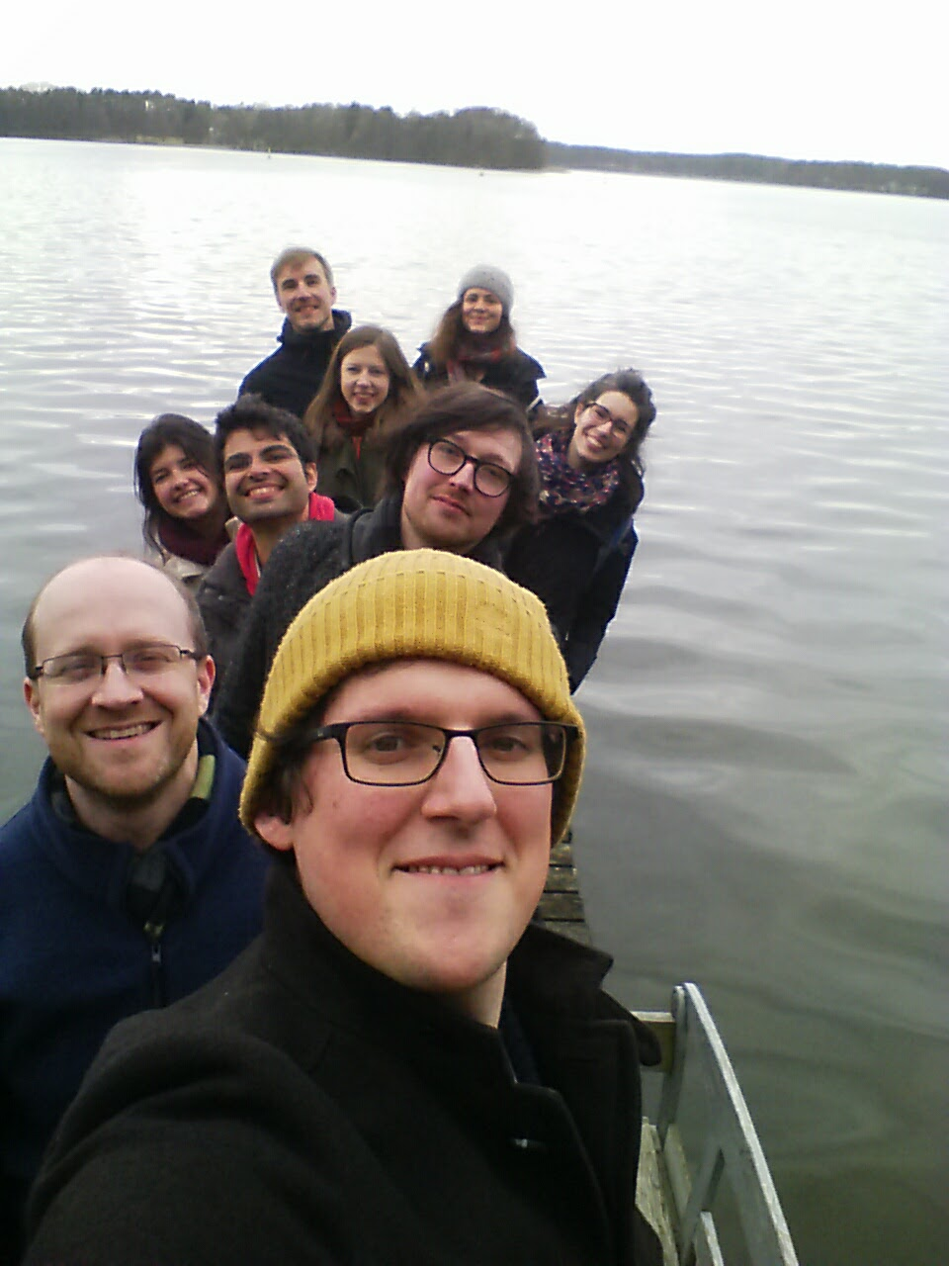
“Code Retreat” - Format
Beforehand
Decide on rough topic (“GPU coding”)
Wednesday
Travel to house
Intro presentation from David Higgins
Discuss concrete plan
Thursday
Code in small groups
Help each other out as needed
Discuss outcomes after dinner

Slide 4
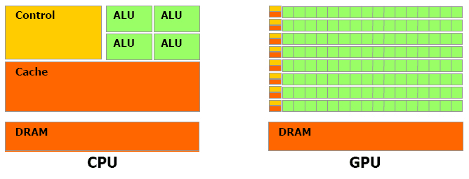
GPU Programming
What is it?
  “Graphics Processing Unit”
  Highly parallelized architecture
  Less flexible than CPU

Slide 5
GPU Programming
Some example uses:
  Linear Algebra
  Differential Equations
    Parallelism in space
  Nonlinear Fitting
    Deep Neural Nets
Not suitable for:
  Different code on every core
  Rapid memory access

Slide 6
Approaches
OpenCL
  Low-level
  Cross-Platform
CUDA
  Low-level
  Nvidia Devices only
Tensorflow/Theano
  High-level
  Cross-Platform
  Used for Neural Network Learning

Slide 7
Approaches
OpenCL
  Low-level
  Cross-Platform
CUDA
  Low-level
  Nvidia Devices only
Tensorflow/Theano
  High-level
  Cross-Platform
  Used for Neural Network Learning

Slide 8
Live Demo...

Slide 9
Outlook
Auditory
stimulation
?
Extracellular
Field Potential

Slide 10
Wiener Filter
Linear filter that minimizes squared error between predicted and recorded system output
Input
Filter
Output

Slide 11
Feedback filter idea
Adaptive filter gain based on output
Non-linear fit needed
Future: online stimulation?
Input
Input
Filter
Output
Gain

Slide 12
Conclusion
Code Retreat
  Every group got working code
  Fun was had
GPU Programming
  Can speed up some computations significantly
  Easy to get started
https://github.com/daveh19/GPU_workshop

